Slide 1
Monopoly Market

Slide 2
Monopoly Market
Monopoly is the polar opposite of perfect competition
Pure Monopoly: Industry is the firm!

Slide 3
Monopoly Market
Structure:
Many buyers and single seller.
Buyers are price takers and seller is the price maker
No close substitutes for product
Significant barriers to entry
Ownership of a unique resource (Diamonds)
Government granted rights for exclusive production (e.g. patents, copyrights, licenses, concessions)
Economies of scale and declining long-run average costs

Slide 4
Implications
Monopolist faces the entire market demand curve.
Profits can persist in the short and long-run.
Possibility of price discrimination
Prices in excess of marginal cost
Consumer choice limited

Slide 5
Demand Curves
A Competitive Firm’s
Demand Curve
A Monopolist
's Demand Curve
Price
Price
Demand
Demand
0
Quantity of Output
0
Quantity of Output
Copyright © 2004 South-Western
Notes:
5

Slide 6
Demand and MR curves
Price
$11
10
9
8
7
6
5
4
3
Demand
2
Marginal
(average
1
revenue
revenue)
0
–1
1
2
3
4
5
6
7
8
Quantity of Water
–2
–3
–4
Copyright © 2004 South-Western
Notes:
6

Slide 7
Price Determination
As in perfect competition, profit for the monopolist is maximized at a point where MC = MR.
What is different for a monopolist ?
marginal revenue does not equal price; marginal revenue is below price.

Slide 8
Price Determination-short run
Costs and
Revenue
. . and then the demand
The intersection of the
curve shows the price
marginal-revenue curve
consistent with this quantity.
and the marginal-cost
curve determines the
B
profit-maximizing
Monopoly
quantity . . .
price
Average total cost
A
Marginal
Demand
cost
Marginal revenue
0
Q
Q_{MAX}
Q
Quantity
Copyright © 2004 South-Western
Notes:
8

Slide 9
Monopolist’s Profit-short run
Costs and
Revenue
Marginal cost
Monopoly
E
B
price
Monopoly
Average total cost
profit
Average
total
D
C
cost
Demand
Marginal revenue
0
Q_{MAX}
Quantity
Copyright © 2004 South-Western
Notes:
9

Slide 10
Vidyut Vitran Nigam is the sole supplier of electricity in a city. The demand and Marginal costs of electricity are given by-
P= 200-4Q MC=4Q
What is the profit maximising price and quantity?

Slide 11
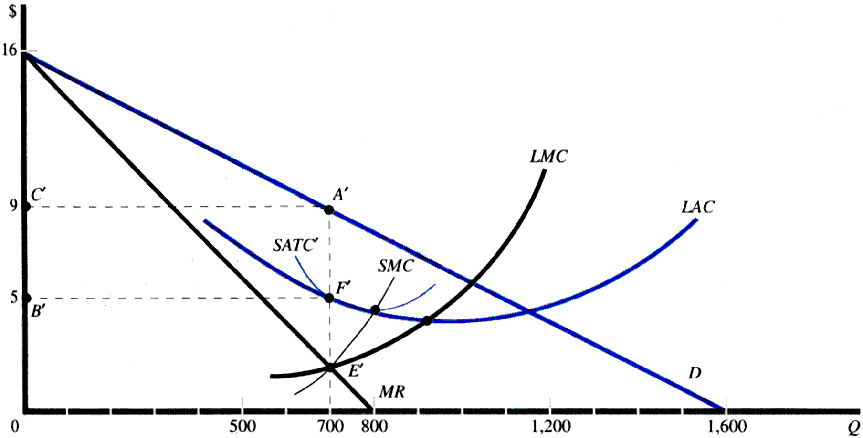
Monopolist’s Profit-long run

Slide 12
Social Cost of Monopoly
In competitive markets, firms produce where
P=MC
And since
P=MR=willingness to buy
And
MC=willingness to sell
P=MC → MR=MC or
Maximum total surplus

Slide 13
Inefficiency of monopoly in comparison to perfect competition market
Price
Consumer
surplus
Monopoly
Deadweight
price
loss
Profit
Marginal cost
Marginal
Demand
revenue
0
Quantity sold
Quantity
Copyright © 2004 South-Western
Notes:
13

Slide 14
Price discriminating Monopolist
Price discrimination is the ability to charge different prices to different customers.
Automobiles are seldom sold at their sticker price.
Theaters have midweek special rates.
Restaurants generally make most of their profit on alcoholic drinks and just break even on food.
College-town stores often give students discounts.
Movie theaters give senior citizens and child discounts.

Slide 15
The demand of a monopolist is given by
P= 50-2Q and marginal cost is Rs 10.
Compute the dead weight loss associated with monopoly pricing.

